Slide 1

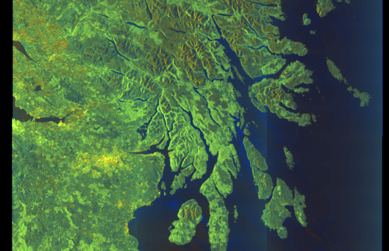
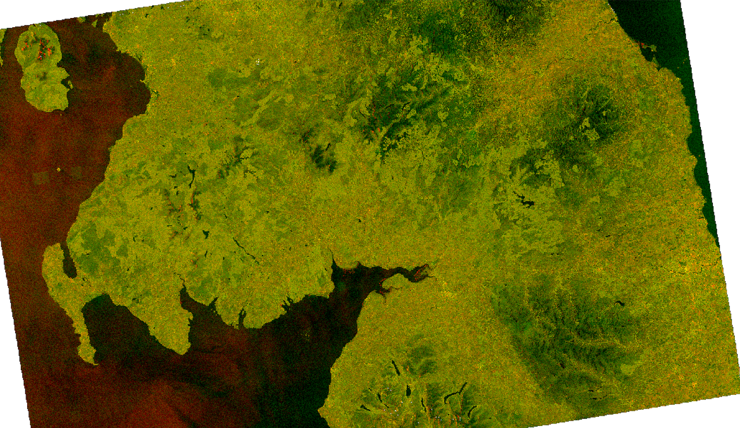

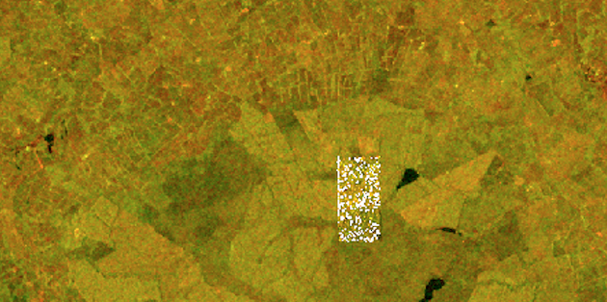
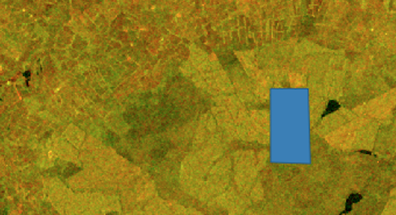

ScotCropMap – High-Level Data Management Workflow
ESA
Perform Earth scan every 5 days to record & save raw image data
JNCC
Run scripts to correct image (radiometry, geometry) & create field segmentation
Scot Gov,
Agri. Analysis
Search images to flag radio interference artefacts
QA data file and run Machine Learning model to classify crops
U of Edinburgh, EPCC
Run script to remove artefacts
Run script to create CSV data file
Create an on-line Scottish Crops Map

Slide 2
ScotCropMap – Detailed Data Management Workflow
Team | INPUTS | ACTIVITY / PROCESS | OUTPUTS | TOOL | STORAGE & COMPUTING SITE | FORMAT
ESA | Radar signal | Perform Earth scan every 5 days to record raw image data | Raw ESA image | Sentinel-1 | ESA | .zip flies
JNCC | Raw ESA image | Run scripts to correct image (radiometry, geometry) | Corrected JNCC image | In-house tool | JNCC server | .tif
JNCC | Corrected JNCC image | Create field segmentation | Field segmentation info | Orfeo | EPCC VM | .shp
Scot Gov, Agri. Analysis | Corrected JNCC image | Search images and flag radio interference artefacts | Flagged artefacts image | QGIS | Local machine to USB stick | .tif
University of Edinburgh, EPCC | Flagged artefacts image | Run script to remove artefacts | Final image | Python | EPCC VM | .shp
DEFRA | Inspections reports | Record, update and save inspections details | Ground Truth | In-house tool | Local machine to USB stick | CSV
University of Edinburgh, EPCC | Field segmentation info Final image Ground Truth | Run script to create a flat Scotland crops dataset | Scotland Crops dataset | Python | EPCC VM | CSV
Scot Gov, Agri. Analysis | Scotland crops dataset | - Perform data clean-up; - Run Machine Learning model such as Random Forest and Neural Nets to classify crops | Scotland Classified Crops dataset | R | Local machine or EPCC VM | CSV
University of Edinburgh, EPCC | Map shape files ? Scotland Classified Crops dataset | Run script to create an open access free on-line Scottish Crops Map | Scottish Crops Map |  | EPCC VM

